Slide 1
ELEMENTARY STATISTICS, BLUMAN
Empirical Rule Example
© 2019 McGraw-Hill Education. All rights reserved. Authorized only for instructor use in the classroom. No reproduction or further distribution permitted without the prior written consent of McGraw-Hill Education.

Slide 2
Objectives for this PowerPoint
Use the Empirical Rule

Slide 3
Empirical Rule
When a distribution is bell-shaped, the following statements are true:
Approximately 68% of the data values will fall within 1 standard deviation of the mean.
Approximately 95% of the data values will fall within 2 standard deviations of the mean.
Approximately 99.7% of the data values will fall within 3 standard deviations of the mean.

Slide 4
Example 1 (1)
The average birthweight for babies born in the US is 7.5 lbs. Assume birthweights are normally distributed and that the population standard deviation is 1.0 lbs. What is the approximate percentage of babies born in the US with a birthweight of between 6.5 and 8.5 lbs?

Slide 5
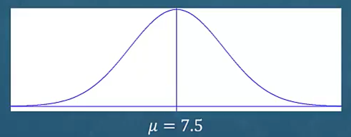
Example 1 (2)
We are told this variable is normally distributed. This implies that the distribution of data values has a bell shape.
We are told the mean is 7.5 and the standard deviation is 1.0.

Slide 6
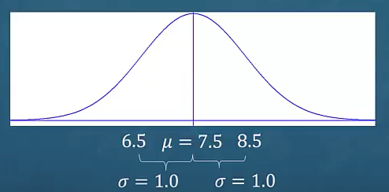
Example 1 (3)
If we add 1 standard deviation to the mean we end up with a value of 8.5. If we subtract 1 standard deviation from the mean we end up with a value of 6.5.
The Empirical Rule tells us that approximately 68% of the data values will fall within 1 standard deviation of the mean. The percentage of babies born in the US with birthweights between 6.5 and 8.5 pounds is approximately 68%.

Slide 7

Example 2 (1)
What is the approximate percentage of babies born in the US with a birthweight of between 5.5 and 9.5 pounds?
What happens when we subtract 2 standard deviations from the mean and add 2 standard deviations to the mean?
$$μ−2σ=7.5−2∗1.0=5.5$$
$$μ+2σ=7.5+1∗1.0=9.5$$
Recall from the Empirical Rule that approximately 95% of the data values fall with 2 standard deviations of the mean.

Slide 8
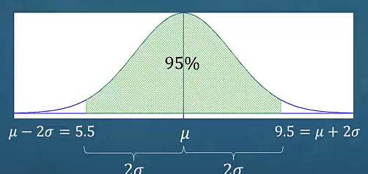
Example 2 (2)
Since we have constructed an interval that is within 2 standard deviations of the mean for a bell-shaped distribution we can use the Empirical Rule to conclude that the percentage of babies born in the US with a birthweight between 5.5 and 9.5 pounds would be approximately 95%.

Slide 9
Summary
In this PowerPoint we learned how to use the Empirical Rule.

